Slide 1
Classification and Detection using Convolutional Neural Networks
Prasanna Venkatesan Srinivasan
psrinivasan48@gatech.edu

Slide 2
The problem
Detect and classify sequence of numbers using CNN
Composed of two problems
Object detection
Object recognition

Slide 3
The Object Detection Flow
Conversion of image to grayscale
Apply MSER and identify blobs
Remove insignificant blobs
Wider blobs
Very small blobs (5% of original image threshold)
Very large blobs (75% of original image threshold)
Feed the output to the Digit Recognition model
Apply non-maximal supression

Slide 4
The Object Recognition Flow
Input Image (32,32,1)
The CNN
Accepts 32*32 input grayscale images
Conv2D(shape=3*3, filters=32)
Dense(11, Softmax)
Batch Normalization
Dense(128, ReLu)
Max Pooling(shape=2*2, stride=2)
Dense(256, uniform)
Conv2D(shape=3*3, filters=64)
Flatten
Conv2D(shape=3*3, filters=128)
Max Pooling(shape=3*3, stride=2)
Max Pooling(shape=3*3, stride=2)
Conv2D(filters=3*3, filters=512)
Conv2D(shape=3*3, filters=256)
Dropout(0.2)

Slide 5
The Object Recognition flow
11 output classes – 0 – 10
0-9 digits – Trained using format 2 SVHN (Single Digit)
10 non-digit – Trained using cropped format 1 SVHN
Optimizer – SGD
Error – Categorical Cross Entropy
0.2 validation split
Stopping condition – No improvement in val_loss in 5 successive epochs

Slide 6
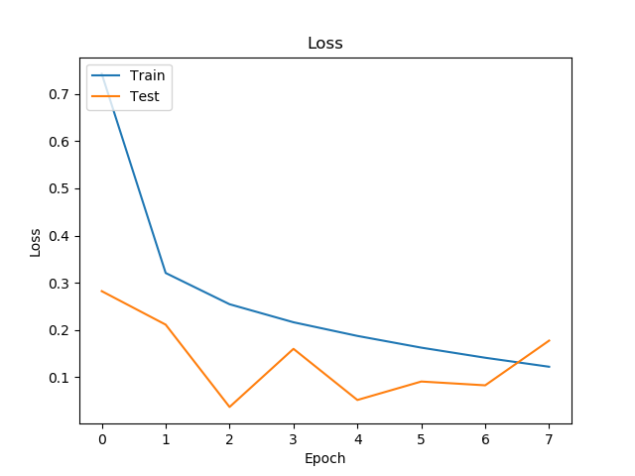
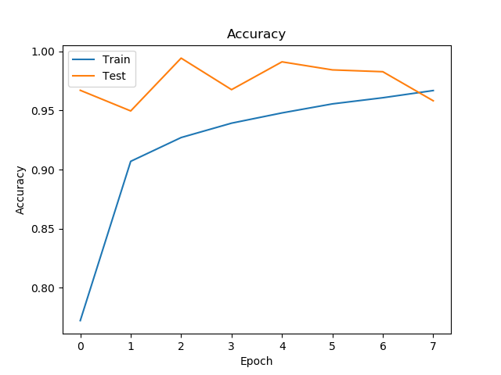
Results
Model | Training Accuracy | Validation Accuracy | Test Accuracy | Loss (Test) | Number of Epochs to Train
Custom CNN | 96.69% | 95.82% | 94.93% | 0.2285 | 8
VGG 16 | 99.25% | 97.91% | 94.80% | 0.2576 | 15
VGG 16 pretrained | 98.81% | 97.46% | 95.90% | 0.1707 | 8

Slide 7
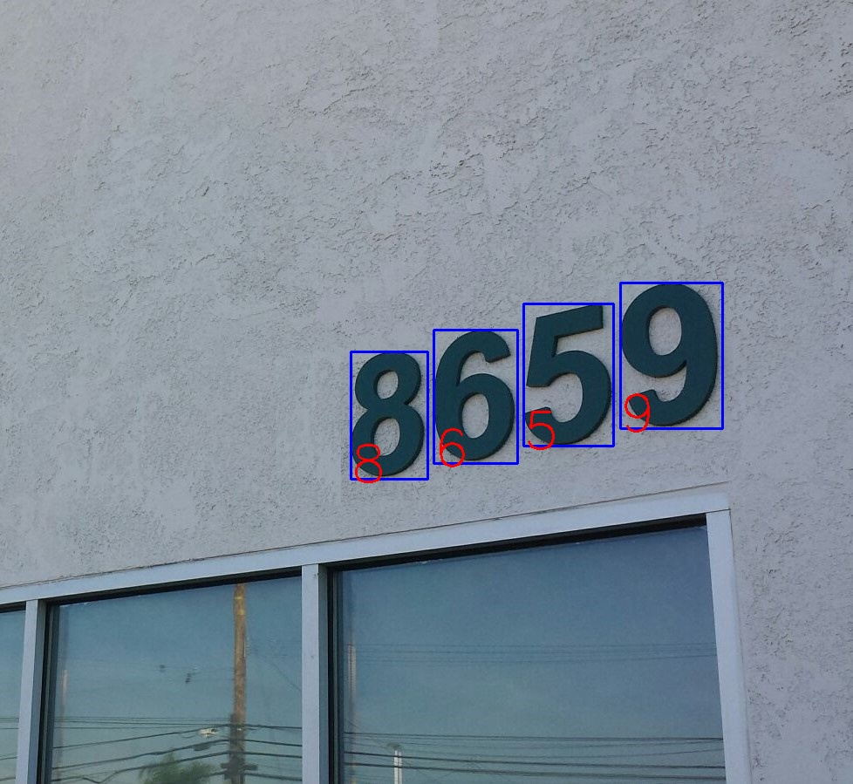
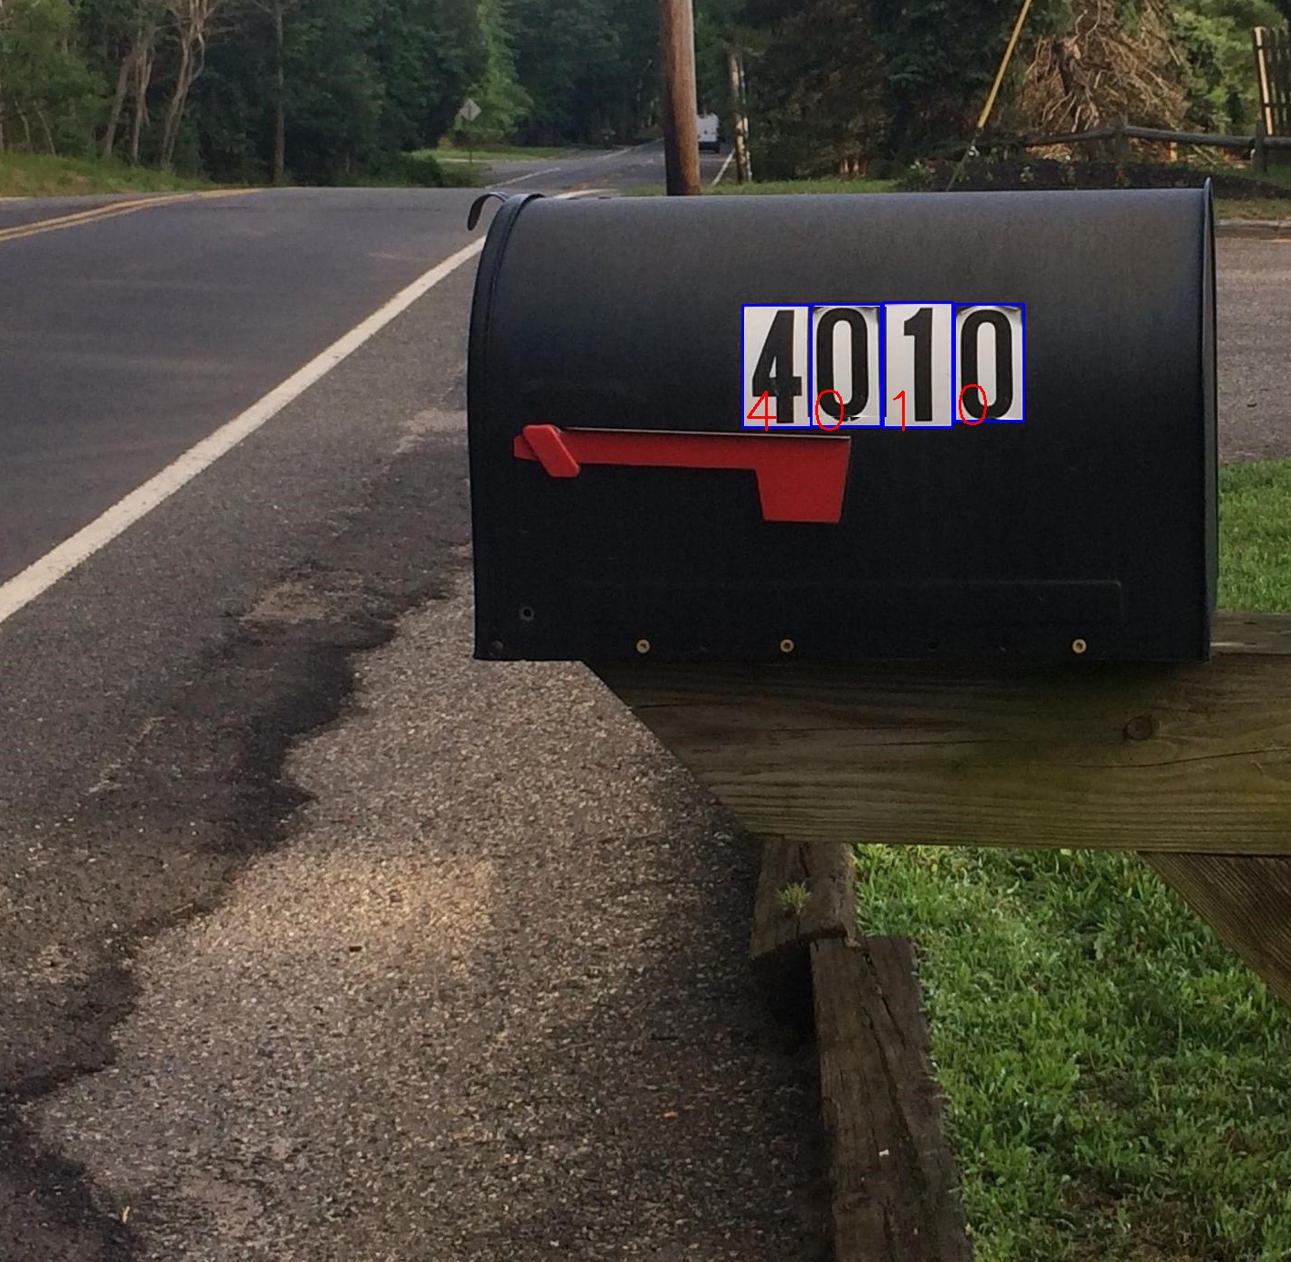
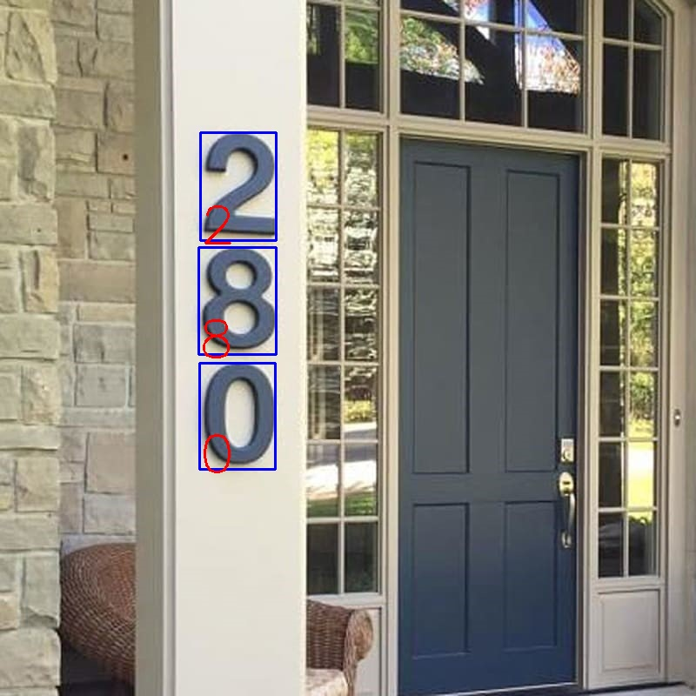
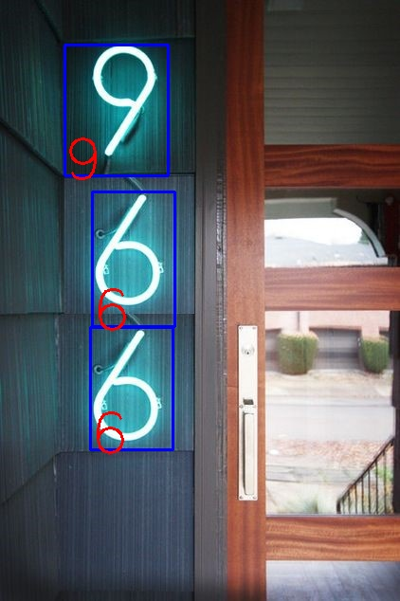
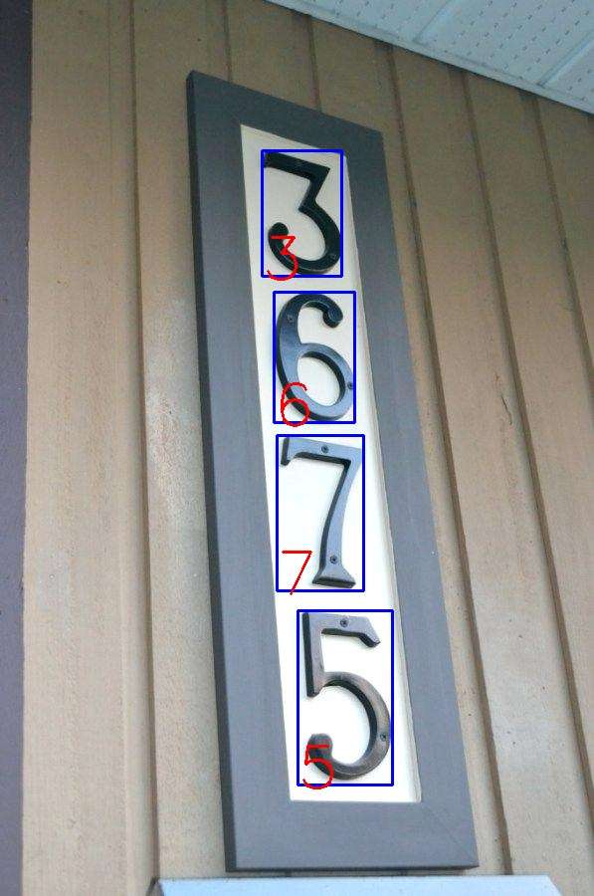
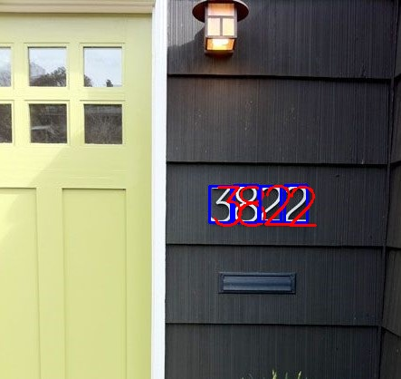
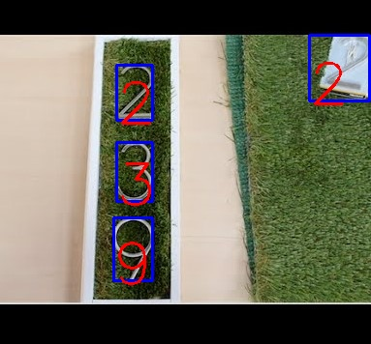
Results - Correct

Slide 8
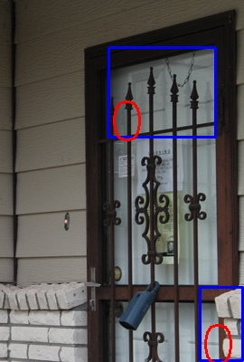
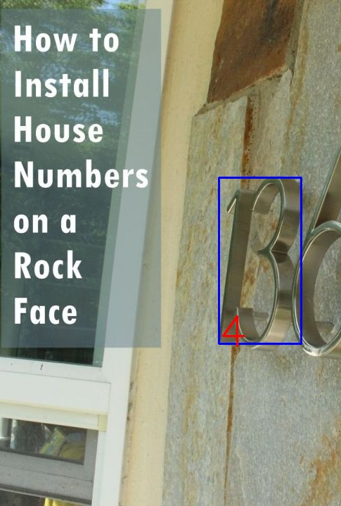
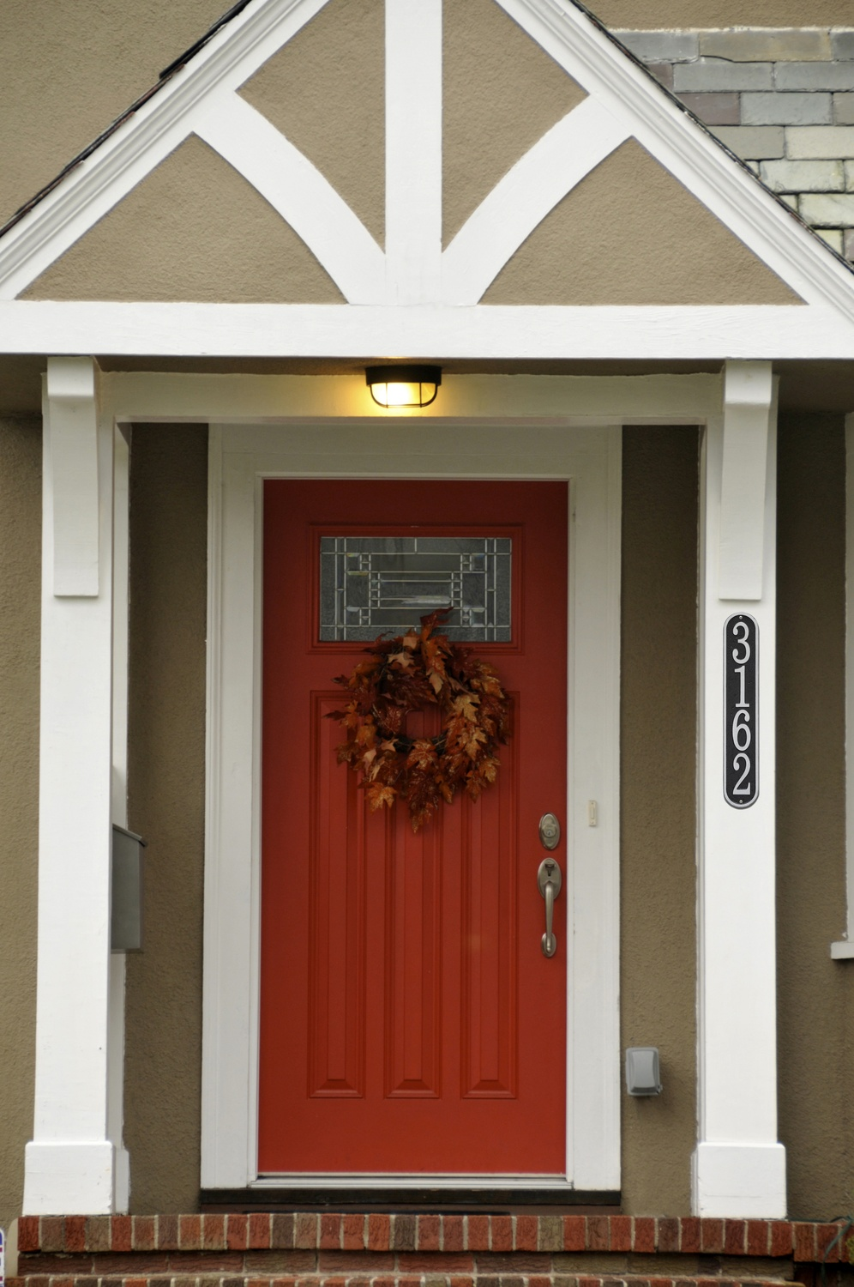
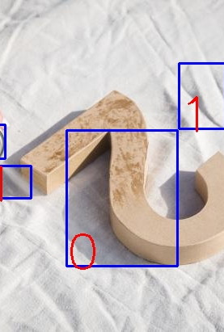
Results Incorrect

